Slide 1
OSI Model

Slide 2
The Open Systems Interconnection model (OSI model) is a conceptual model that characterizes and standardizes the communication functions of a telecommunication or computing system without regard to its underlying internal structure and technology.
Notes:
Source: https://en.wikipedia.org/wiki/OSI_model

Slide 3
7 Layers of OSI
Application
Presentation
Session
Transport
Network
Data Link
Physical

Slide 4
Application
This layer is the closest to the user.
It is essentially our application
Is responsible for things like synchronising communications, Accessing resources

Slide 5
Presentation
Translates data between application and session
Takes data passed to it and converts it to some representation that the network understands by design.
Such as serialization of object and data structures to XML format.

Slide 6
Session
Used to establish, manage and terminate connections between local and remote applications.
Deals with connation and session coordination, IE the data being passed between applications

Slide 7
Transport
Provides transparent transfer of data between systems.
Responsible for end-to-end error recovery and flow control.
Segmentation/de-segmentation of data
Retransmission of failed data
Ensures quality of service

Slide 8
Network
Switching and routing
Crates logical paths to nodes (virtual circuits)
Addressing (IP addresses)
Congestion control
Packet sequencing

Slide 9
Data Link
Encodes/ Decodes data packets in to bits
Handles errors in physical layer
Responsible of frame synchronisations
Divided in to 2 sub layers
Media Access Control layer (MAC)
Logical Link Control layer (LLC)

Slide 10
Physical
The actual wires
Conveys the bit stream: electrical impulses, light or radio signals

Slide 11
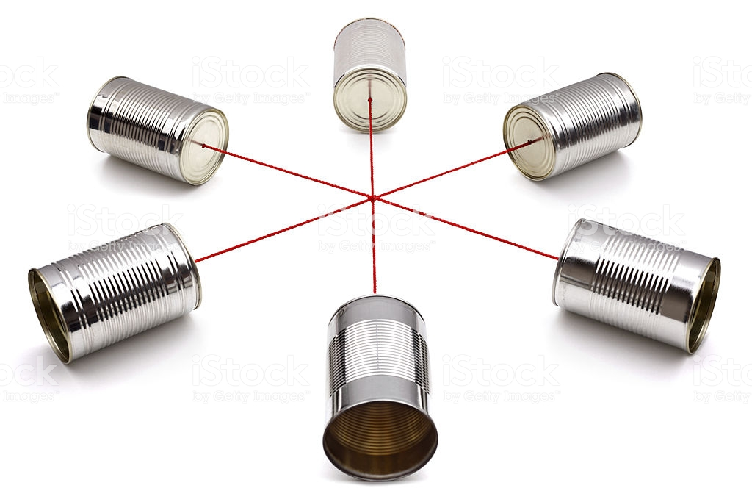
Important to remember
The OSI model is a conceptual model.
Each layer can be implemented anyway you want as long as it follows the standards.
IE the physical layer could be made out of baked bean tins and string
Almost all of it has already been made for you
You just need to worry about the application layer (usually).
The rest is written and you just include it in you application.

Slide 12
Questions?

